Slide 1
IB Diploma Program Scheduling Information for 10th graders -
Choosing your classes
Notes:
Para escuchar en español:
llame 888-721-8686
luego ingrese el número de identificación: 725-785-1958
This presentation will walk you through the creation of a two year plan.
Thank you for joining us tonight. I do want to let you know that this presentation is being recorded.
Access#: 888-721-8686
Conf ID(passcode): 725 785 1958

Slide 2
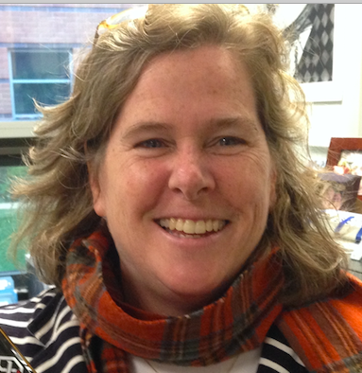
Julie Cantor, IB DP Coordinator
julie.cantor@apsva.us
@WLHSIBProgram
Notes:
My name is Julie Cantor. I am the diploma program coordinator. The best way to contact me is through email: julie.cantor@apsva.us. I also encourage you to follow the WLIB program on Twitter.

Slide 3
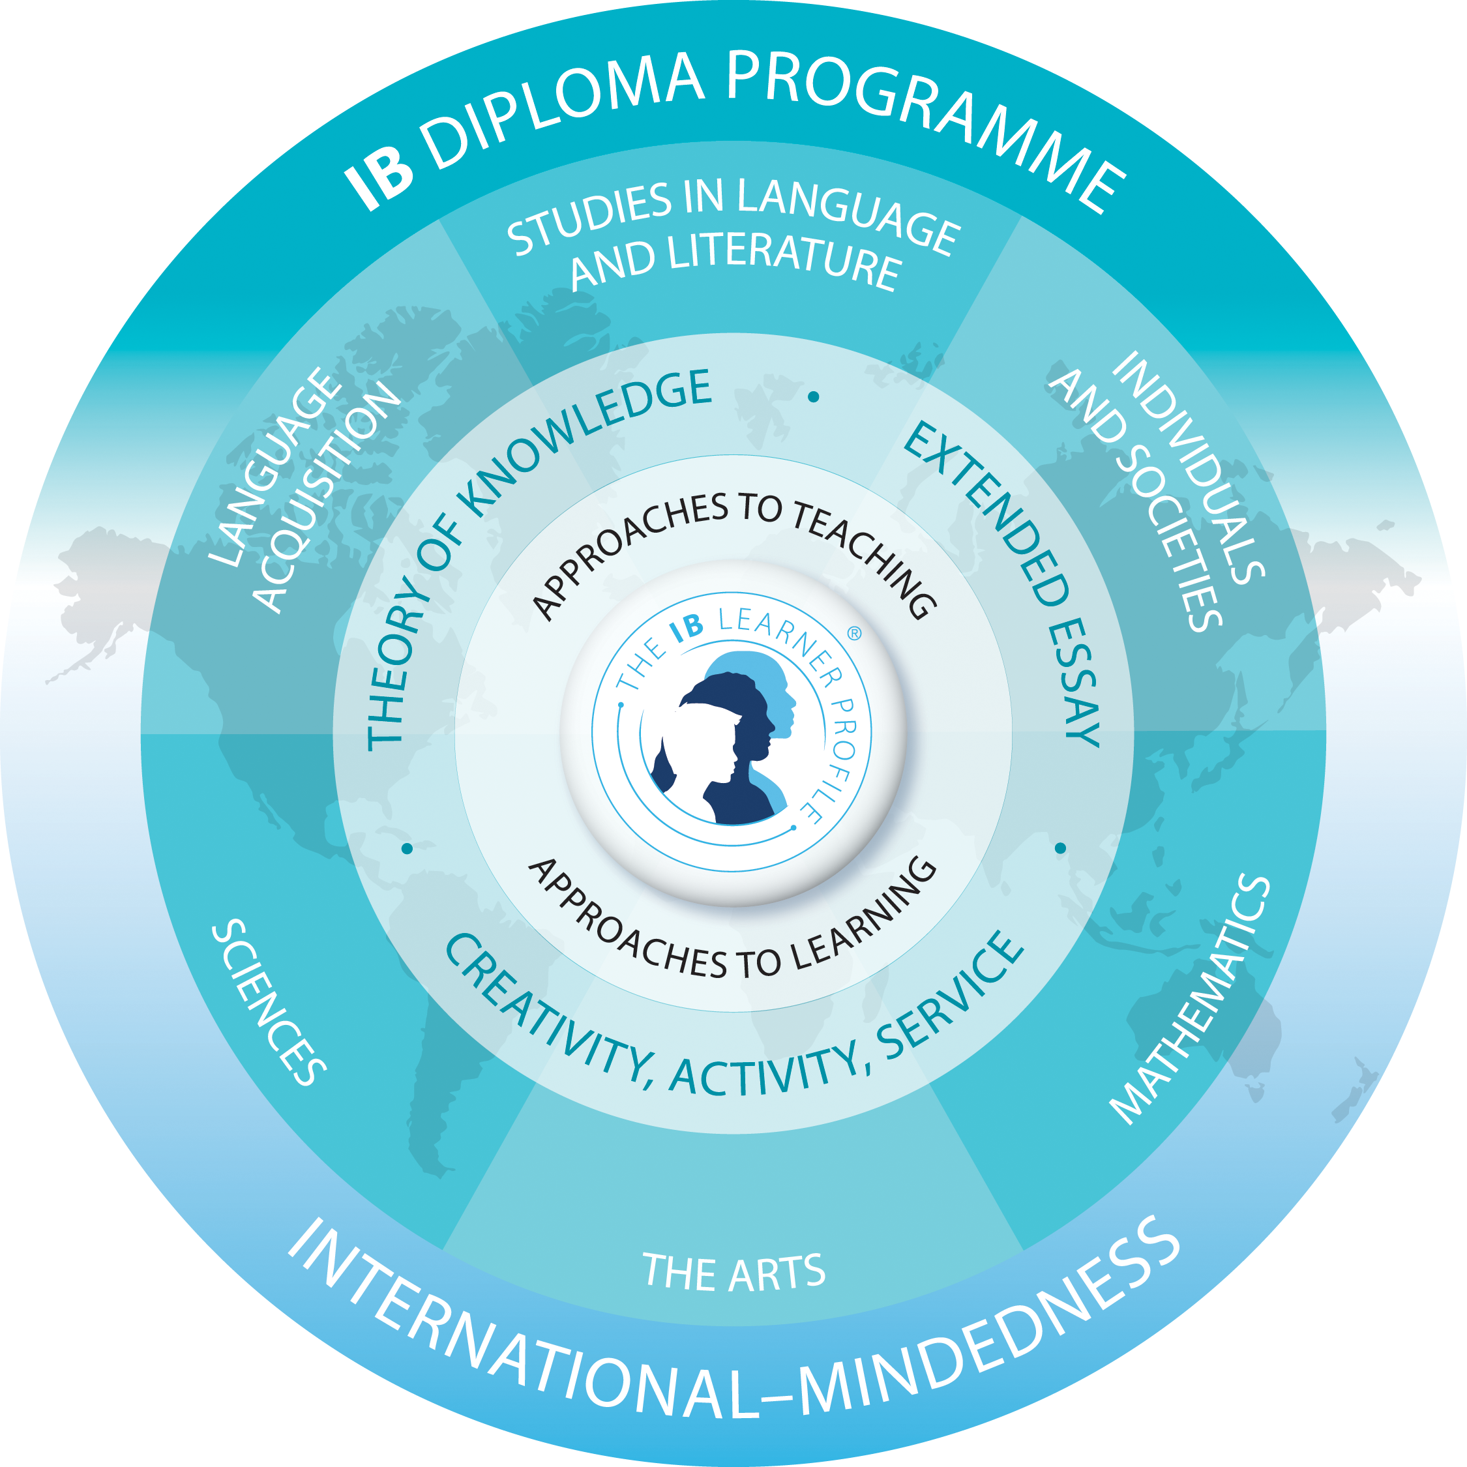
IB Diploma Program
11th & 12th grades
Courses
Six IB Courses
IB Core components
CAS - Creativity, Activity, Service
EE - Extended Essay
TOK - Theory of Knowledge
Focus on whole student, providing students with a broad international view of world and student’s context within it.
Notes:
The IB diploma program is designed for 11th and 12th graders. The program combines academic classes with core requirements. Students take six IB classes over junior year and senior year. These courses last for both years. The count as one IB course credit, but will appear as two credits on the students WL transcript.
In addition to these six classes, students must complete the three core requirements of:
Creativity Activity Service CAS - this is the part where students are challenged to be involved in things outside of the classroom. They will be members of clubs and perhaps a sports team, for example. Through there involvement, they demonstrate their creativity, activity and service and then reflect on their experiences.
The Extended Essay EE - this is a four thousand word essay that students complete over about 12 months. They choose their own topic….born out of a course they are taking, and then research and investigate that topic. This is a unique opportunity that IB provides as the students direct their own education.
Theory of Knowledge TOK is an additional course that students take that challenges them to really consider how they construct their own knowledge…and how others around them are constructing theirs as well…and how that differences has impact in their lives.

Slide 4
What does the IB Diploma Program curriculum contain?
Completed during 11th & 12th grade years
Six subject groups
Must represent Groups 1-5
Group 6 optional
Balance of HL & SL
TOK course
Meet Virginia diploma requirements
Notes:
Tonight we will be focusing on the six courses that IB requires. There are many IB requirements to these classes so we need to be sure to be addressing each of these.
In addition, we are really responding to parallel requirements as these young people are students in a Virginia public school. Our charge, first and foremost, is that students earn their Virginia diploma. So we will be looking at Virginia diploma requirements as well as IB diploma requirements. This gets complicated.
I am going to be your expert for the IB requirements. I want to remind you that the WL Counselors are the experts when it comes to Virginia diploma requirements. I generally have a good understanding of the Virginia diploma requirements, but I do want you to be checking in with your counselors to determine which requirements you still may need to fulfill.
Ok…general reminders for creating your two year plan…and we will be hitting on these as we work our way through this program.
You must choose six IB classes.
Most of these IB classes are two year classes that will meet during both junior and senior years.
Classes must be spread out over Groups 1-5. You must have one class from each of these groups.
Group 6 or the arts, is optional. If you choose not to take a group 6 course, then you will take two courses from one of the other groups.
Also remember you must have a balance of HL and SL classes.
You must plan for the TOK course
Finally, you must also ensure that Virginia diploma requirements are met.

Slide 5
W-L IB Course Selections
Group 1: Language A (all two years)
English Literature HL
English Lang & Lit SL
Spanish Lang & Lit HL
Group 2: Language B (all two years)
Arabic B & AB SL
Chinese B & AB SL
French B HL, SL
Latin B HL, SL
Spanish B HL , SL
Group 3: Individuals and Societies
Business & Management SL (one year)
Economics SL (one year)
Geography SL (one year)
Global Politics SL (one year)
History of Americas and Topics HL
Philosophy SL (one year)
Psychology HL
Psychology SL (one year)
Social Anthropology HL
Social Anthro SL (one year)
Group 4: Experimental Sciences
Biology HL
Biology SL (one year)
Chemistry HL
Computer Science HL
Design Technology SL
ESS SL (one year; block)
Physics SL
Sports, Exercise & Health Science SL
Group 5: Mathematics
Mathematics: A&A HL
Mathematics: A&A SL
Math: A&I SL
Group 6: Arts
Film Study HL
Film Study SL
Music SL (one year)
Theater Arts HL
Theater Arts SL (one year)
Visual Arts HL
Visual Arts SL (one year)
Notes:
This is a list of all IB courses offered at WL.
It is the same list that was provided in the last assignment. This list is available as a resource in the previous assignment.

Slide 6
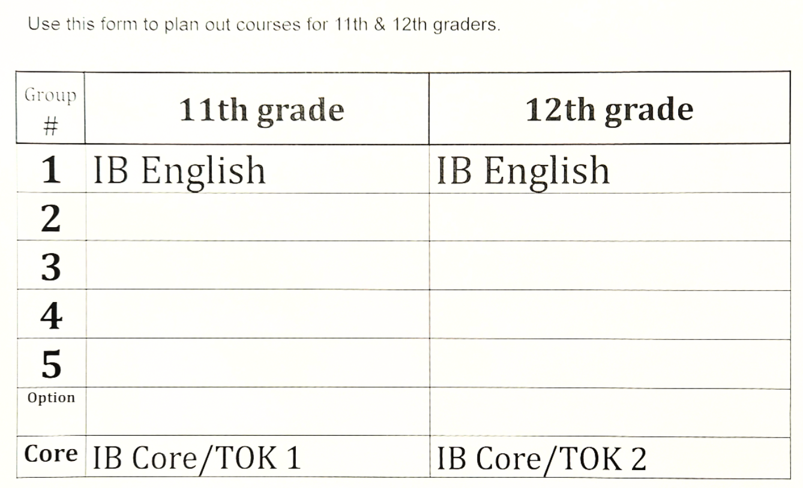
14 SLOTS
(including IB Core/TOK)
MOST IB CLASSES ARE TWO YEARS
Notes:
So now it is your turn to play around with different two year plans configurations.

Slide 7
Sample Two Year Plan
Group # | 11th grade | 12th grade
1 | IB English Language & Literature SL pt 1 | IB English Language & Literature SL pt 2
2 | IB Spanish B HL pt 1 | IB Spanish B HL pt 2
3 | IB History of Americas HL1 | IB History Topics HL2
4 | IB Sports Exercise Health Science SL 1 | IB Sports Exercise Health Science SL 2
5 | IB Math Applications & Interpretation SL 1 | IB Math Applications & Interpretation SL 2
6 | IB Film HL pt 1 | IB Film HL pt 2
Core | IB Core/TOK pt 1 | IB Core/TOK pt 2
Notes:
This is a sample two year plan that I put together so that you can see what our end product will look like.
You saw how many different IB classes WL offers back two slides. Each student should explore the classes that they find to be of most interest to them.
When choosing higher level classes, I want to emphasize that students need these HL classes to be those that are of the most interest to them.

Slide 8
14 SLOTS
(including IB Core/TOK)
MOST IB CLASSES ARE TWO YEARS
Notes:
So now it is your turn to play around with different two year plans configurations.

Slide 9
Creating the Two Year Plan - Checklist
Checklist:
Group 1 class*
Group 2 class (or IB Spanish A Language & Literature HL*)
Group 3 class
Group 4 class
Group 5 class
6th class from any of groups 1-6
HL/SL Balance - 3 HL & 3 SL or 4 HL & 2 SL
IB Core/Theory of Knowledge (TOK)
NO MORE THAN 2 ONE-YEAR IB CLASSES
Economics requirement - Economics & Personal Finance (EPF) or IB Economics
USVA History - IB HOA/Topics History; APUSH; or USVA history
USVA Government requirement
Any other VA diploma requirements?? Be sure to check with counselor
Notes:
This checklist will assist you as you create a two year plan.
IB Requirements:
Select one subject from each subject group (1-5)
Group 6 (Arts) is optional.
If you skip group 6, you must double up on another group.
Balance HL & SL classes: two options- 3 HL & 3 SL; or 4 HL & 2 SL
Theory of Knowledge (TOK) is part of the IB core. It is required.
One-year IB courses are limited. No more than 2 are allowed.
Economics and Personal Finance (EPF) - IB Economics satisfies this requirement while also counting as a Group 3 IB course.
US/VA History - three options: IB HOA/Topics History, AP US History, or US/VA History.
US/VA Government - most have taken in 10th grade. If not, then you must work it into schedule
Other VA Diploma requirements: Check with your counselor to be sure you have met all requirements.

Slide 10
GROUP 1 - Language & Literature
GROUP 2 - Language Acquisition
IB Subject Area Groups
GROUP 3- Individuals & Societies
GROUP 4 - Science
GROUP 5 - Mathematics
GROUP 6 - The Arts
Notes:
These are the six subject groups. We going to work through creating a sample two year plan.

Slide 11
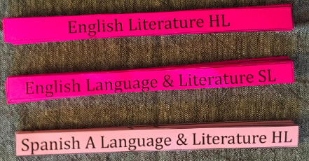
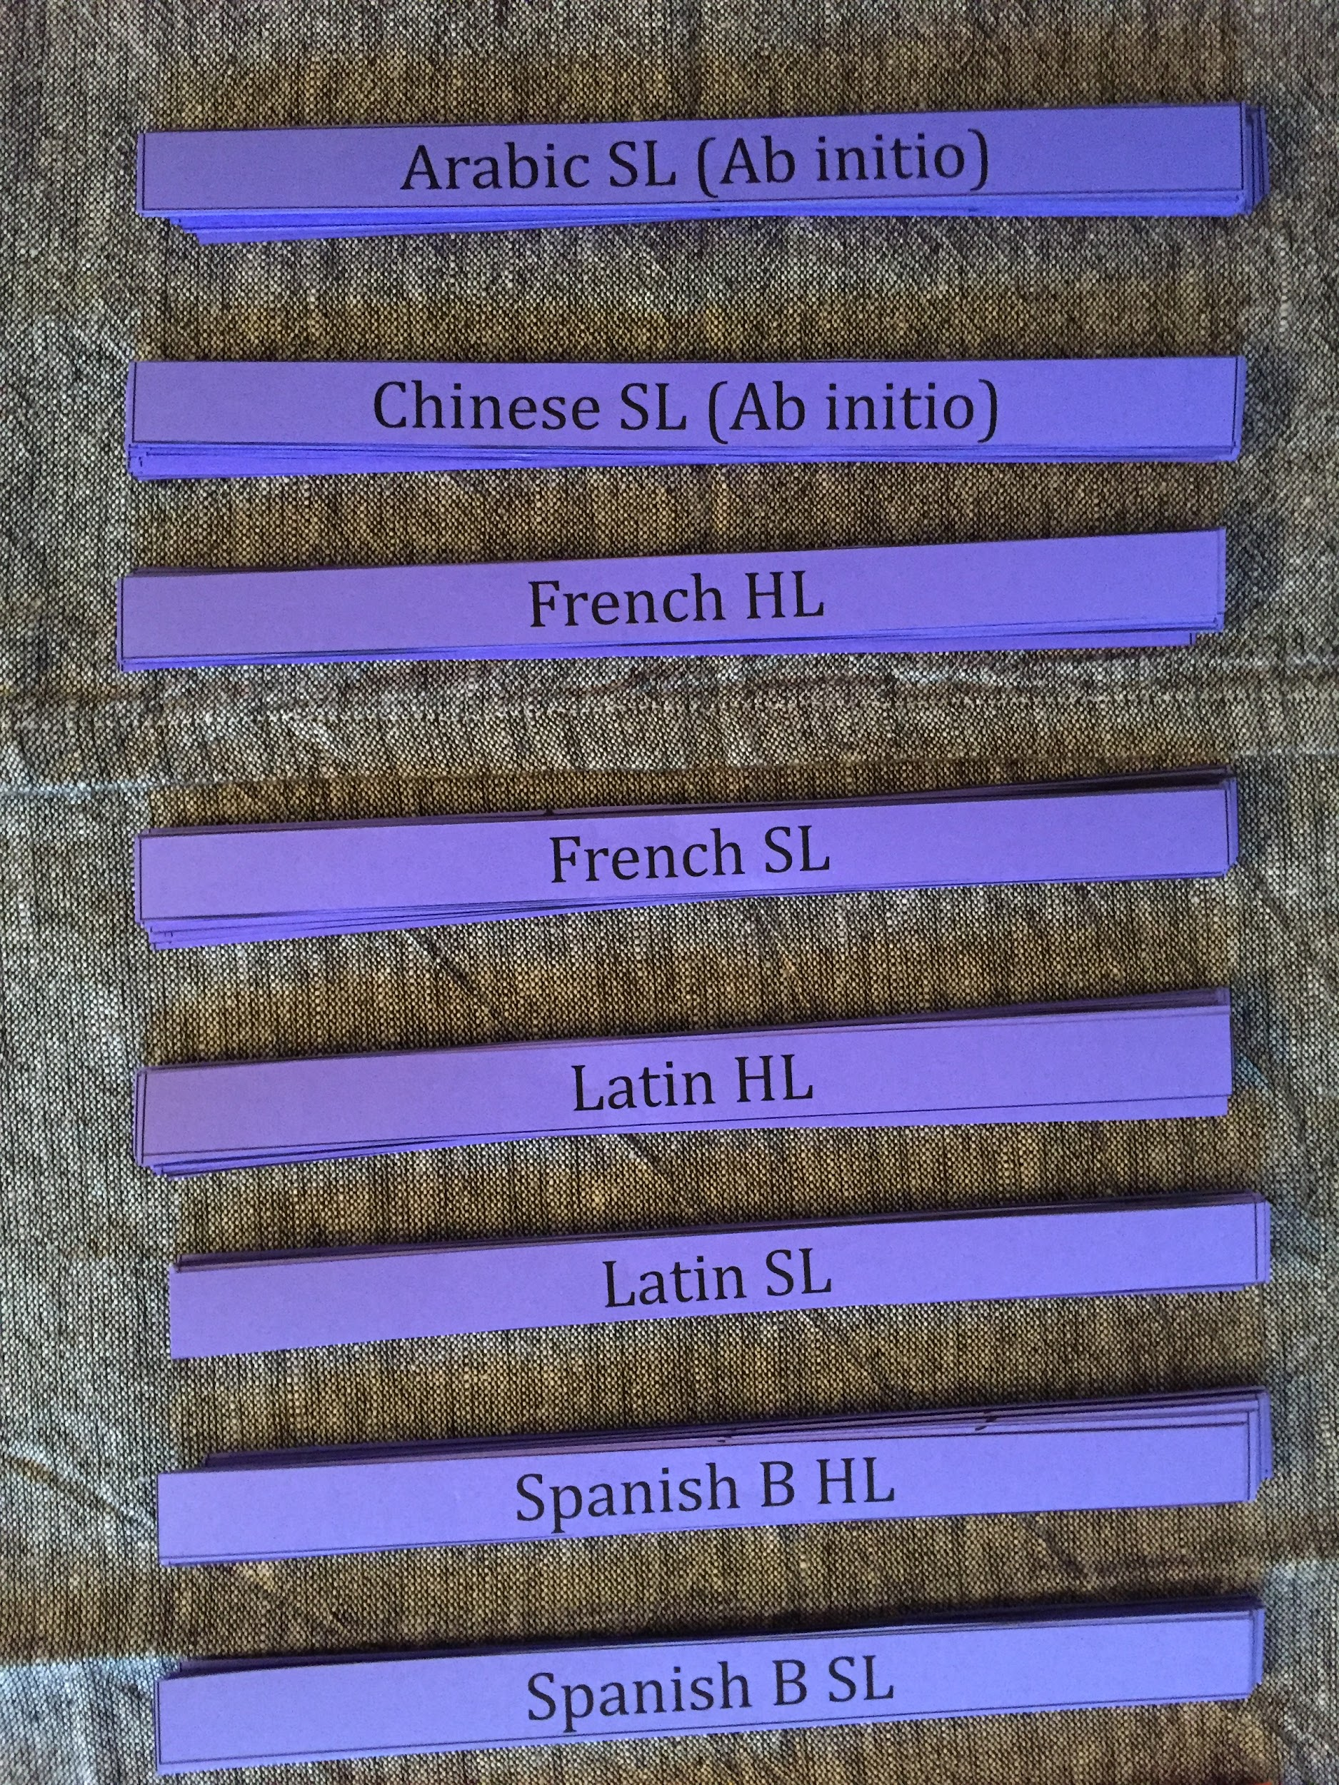
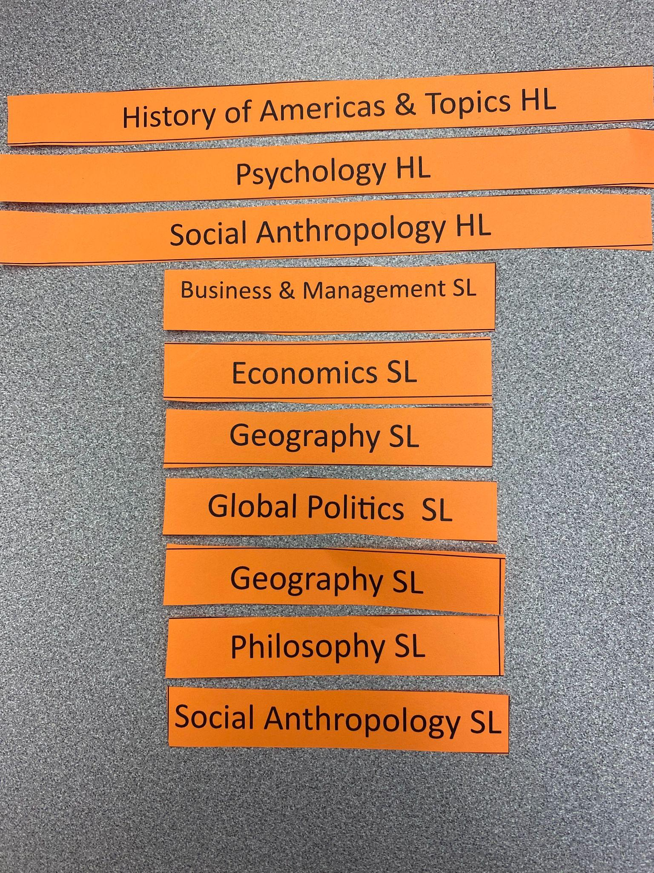
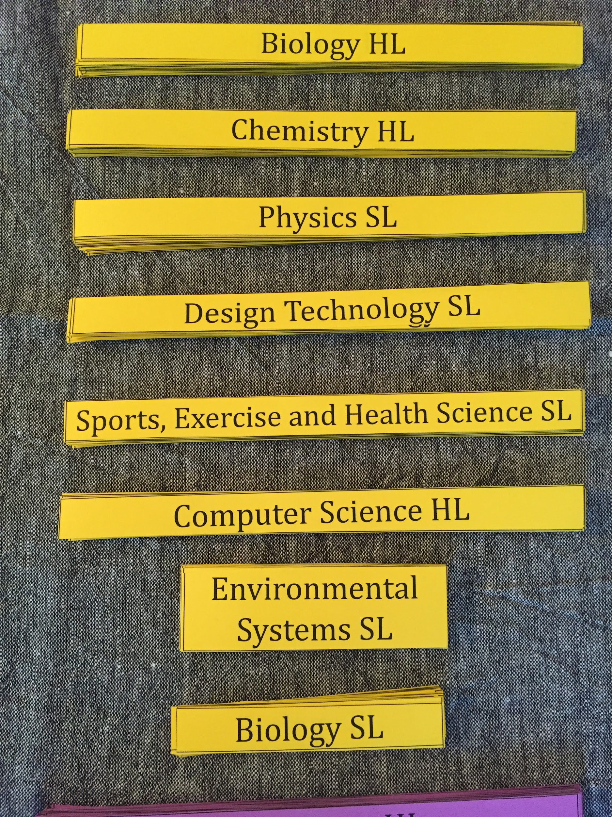
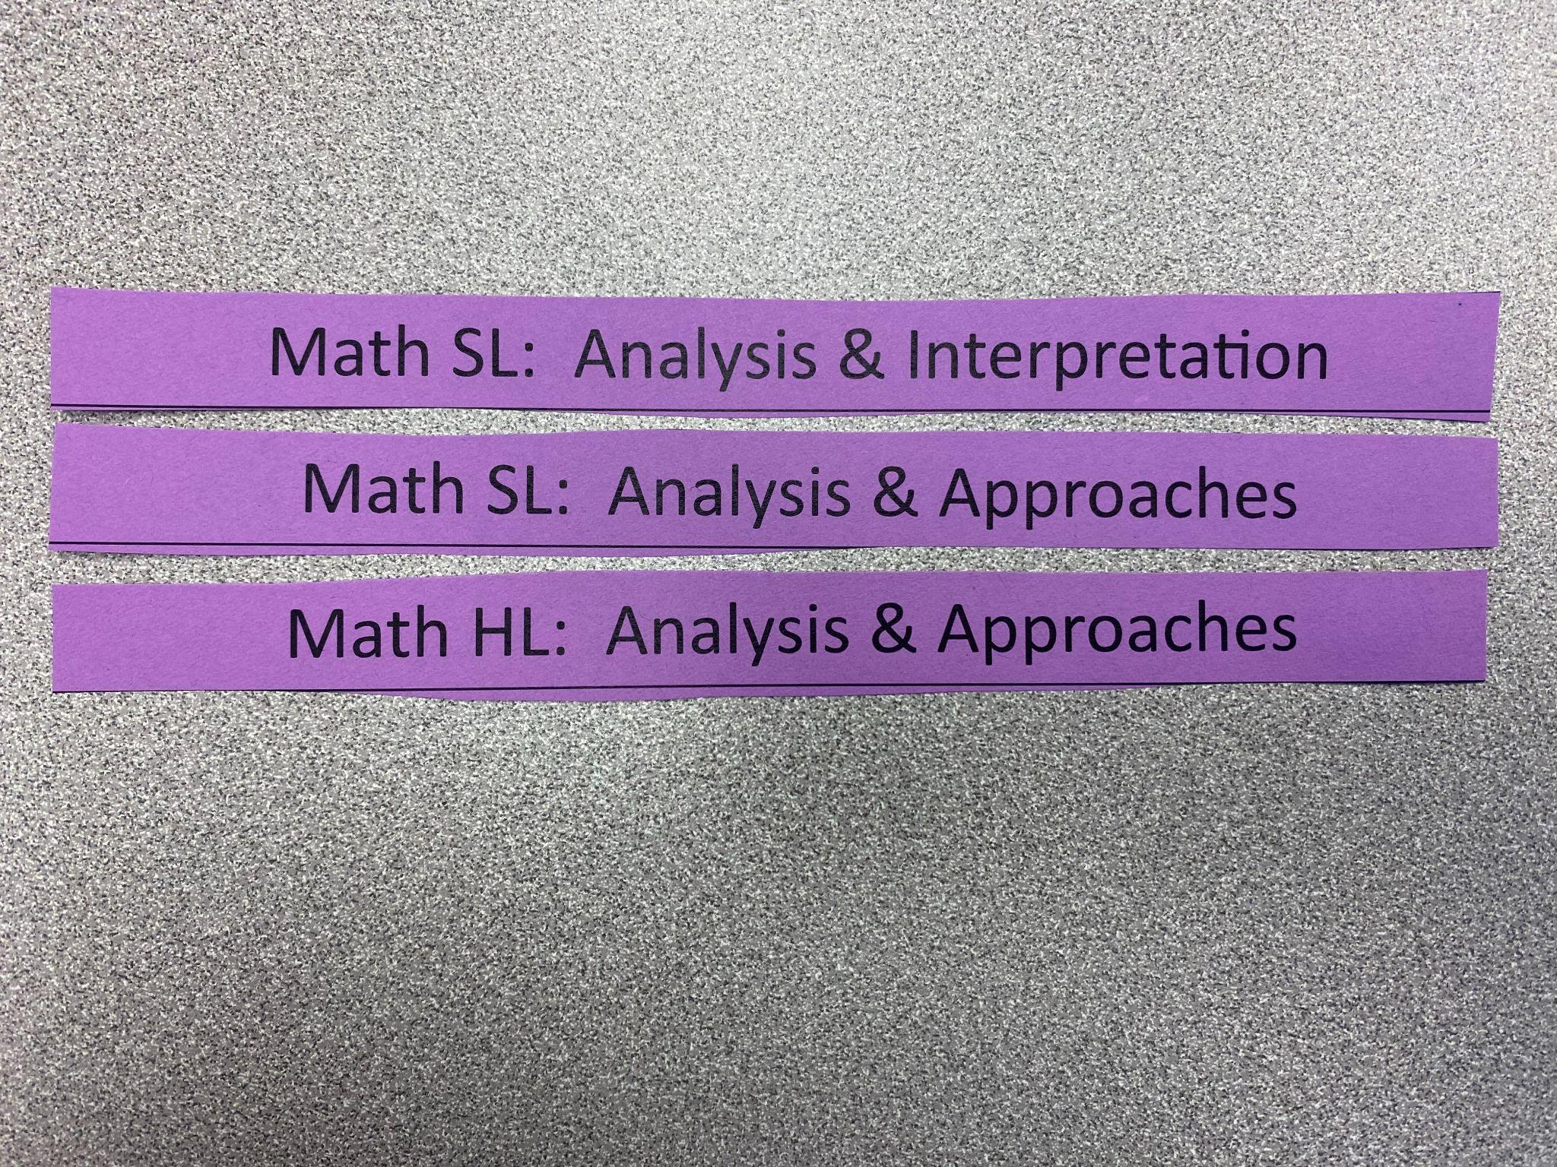
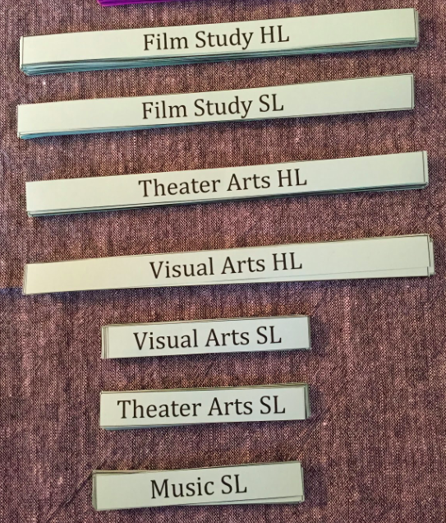
W-L IB Course Offerings
GROUP 1 Language & Literature
GROUP 2 -
Language Acquisition
GROUP 3 - Individuals & Societies
GROUP 4 -
Science
GROUP 5 - Mathematics
GROUP 6 -
The Arts
Lots of choice!!

Slide 12
GROUP 1:
Language
English Literature HL
Spanish Language & Literature HL
Must have English - either HL or SL
Spanish A -
for students currently in FS;
bilingual diploma,
group 2 not required
Notes:
First ….Group 1 - Language & Literature. You must take IB English. Your choice is between IB English Literature HL or IB English Language & Literature SL. Both are two year courses, so in trying to visualize the schedule you can see here the dark pink strip of paper covering the first slot for both junior and senior years.
Remember that IB in an international program. The concept of International Mindedness is a foundational element - and IB wants students to develop their language skills (both their first language and their second language) to the highest level possible.
Students who are fluent Spanish speakers have the option of taking a second Group 1 course: Spanish Language & Literature HL. Students who are recommended for and choose this high level Spanish course will be eligible to earn a bilingual diploma with IB. Students who take Spanish Language & Literature are not required to take a course from Group 2.

Slide 13
GROUP 2:
Language Acquisition
English Literature HL
Chinese Mandarin B SL
Notes:
Most students will choose their Group 2 Language Acquisition course based on the world language that they have now been studying for four years. In this slide, you can see the choice of Chinese SL. This again is a two year course so covers slots for both junior and senior years.

Slide 14
GROUP 3:
Individuals & Societies
English Literature HL
Chinese Mandarin B SL
Global Politics SL
Elective or other
HL = higher level
SL = standard level
One & two year courses
Notes:
Group 3 Individuals & Societies is similar to what refer to as Social Studies. The HL courses in this group are two year course. The SL courses are one year courses. Here you can see Global Politics SL. It takes up just one slot and leaves an open slot for senior year. This open slot might be filled by another IB class or by a non-IB class.
There are some options in Group 3 that hold a dual role: counting as an IB class and fulfilling Virginia diploma requirements. IB History of the Americas HL fulfills the group 3 requirement and the Virginia requirement for USVA History. IB Economics SL also fulfills the group 3 requirement and at the same time the Virginia requirement for Economics & Personal Finance.

Slide 15
GROUP 4:
Science
English Literature HL
Chinese Mandarin B SL
Global Politics SL
Design Tech SL
Environmental Systems - block class
Notes:
Group 4 is the Sciences. There are some exciting options in this group. In this slide you see IB Design Tech SL which is an engineering class.
A couple things to note for this group: IB Biology SL is a one year course so takes up only one slot. IB Environmental Systems and Societies SL is two classed in one year. It is a block class. So instead of taking up one slot in junior year and one slot in senior year, it takes up two slots in the same year.

Slide 16
GROUP 5:
Mathematics
English Literature HL
Chinese Mandarin B SL
Global Politics SL
Design Tech SL
Math - review sequence
Math: Analysis & Approaches SL
Notes:
Group 5 is Mathematics. Your choice of math sequence will be determined by what math class you are currently in. A document to help you determine the appropriate math sequence for you has been uploaded in this assignment. I also encourage you to have conversations with your current math teacher to determine the best math sequence for you.
Please also note that quite of few 10th graders are currently enrolled in part 1 of IB Math Analysis & Approaches SL. These student will take part 2 of this course in junior year. This course fulfills the IB requirement for math. You will still need to take a math class in senior year, but it will not be an IB math class. Some will choose AP Calculus BC, or AP Stats or some other math class.

Slide 17
10th grade | IB 11th grade | IB 12th grade
Algebra 2 | IB Math: Applications & Interpretation SL Pt.1 | IB Math: Applications & Interpretation SL Pt.2
Algebra 3 or Precalculus (Grade - A or B) | IB Math: Applications & Interpretation SL Pt.1 Recommended | IB Math: Applications & Interpretation SL Pt.2 Recommended
 | IB Math: Applications & Interpretation SL | Other Non-IB Math
Algebra 3 or Precalculus (Grade - low B,C or D) | IB Math: Applications & Interpretation SL Pt.1 | IB Math: Applications & Interpretation SL Pt.2
Pre-calculus Dual Enrollment (Grade - A or B) | IB Math: Analysis & Approaches SL Pt. 1 (Intensified PreCalc) | IB Math: Analysis & Approaches SL Pt. 2 (AP Calculus AB OR AP Calculus BC)
 | IB Math: Applications & Interpretation SL Pt.1 | IB Math: Applications & Interpretation SL Pt.2
Pre-calculus Dual Enrollment (Grade - low B,C or D) | IB Math: Applications & Interpretation SL Pt.1 | IB Math: Applications & Interpretation SL Pt.2
Algebra 2 Intensified (Grade A or B AND teacher rec) | IB Math Analysis & Approaches SL Pt. 1 (Intensified PreCalc) | IB Math: Analysis & Approaches SL Pt. 2 (AP Calculus AB OR AP Calculus BC)
Algebra 2 Intensified (Grade - low B,C or D) | IB Math: Applications & Interpretation SL Pt.1 | IB Math: Applications & Interpretation SL Pt.2
IB Math Analysis & Approaches SL Pt. 1 (Int. PreCalc) - (Grade A or B AND teacher rec) | IB Math: Analysis & Approaches SL Pt. 2 / IB Maths HL Pt. 1 - (AP Calculus BC) | IB Maths HL Pt. 2 OR Multivariable Calculus
IB Math Analysis & Approaches SL Pt. 1 (Intensified PreCalc) - (Grade - low B, C or D) | IB Math: Analysis & Approaches SL Pt. 2 (AP Calculus AB) | AP Calculus BC OR AP Statistics
IB Math A&A SL Pt. 2 (AP Calculus AB) | IB Maths HL Pt. 1 - (AP Calculus BC) | IB Maths HL Pt. 2

Slide 18
GROUP 6:
The Arts
English Literature HL
Chinese Mandarin B SL
Global Politics SL
Design Tech SL
Math: Analysis & Approaches SL
Film Study SL
The Arts - not required, may choose two of another group
Notes:
Finally we come to your sixth IB subject course...for this course you may choose a Group 6 Arts option. Those include Film, Theater and Visual Arts. If you choose not to take a Group 6 course, then you will choose a second Group 2, 3 or 4 course.

Slide 19
PROBLEMS?
Checklist:
Group 1 class*
Group 2 class (or IB Spanish A Language & Literature HL)
Group 3 class
Group 4 class
Group 5 class
6th class from any of groups 1-6
3 HL classes & 3 SL classes OR 4 HL classes & 2 SL classes
Economics requirement (Economics & Personal Finance or IB Economics)
US History requirement (IB History (HOA/Topics); APUSH; or USVA)
US Government requirement
NO MORE THAN 2 ONE-YEAR CLASSES
Theory of Knowledge (TOK)
English Literature HL
Chinese Mandarin B SL
Global Politics SL
Design Tech SL
Math: Analysis & Approaches SL
Film Study SL
Notes:
OK...we now have six IB course chosen ….but we need to check to be sure these choices fulfill all the IB requirements and Virginia diploma requirements.
Are all six subject groups represented? Yes. We are good with that.
Do we have a balance of HL and SL courses? Either 3 and 3 or 4 HL and 2 SL. Here we identify a problem. This list of courses only represents one HL course. So now you would need to go back to the course options and figure out which SL courses to swap out in favor of HL courses.
We also need to be sure you are mindful of the Virginia diploma requirements. Many students are currently taking AP US government so you would be set with that one. If you are not in that class, then you need to think about how you will fit it in.
Additionally you need think about USVA History and Economics and Personal Finance. Some students make use of summer school offerings to meet some of these requirements.

Slide 20
PROBLEMS?
Checklist:
Group 1 class*
Group 2 class (or IB Spanish A Language & Literature HL)
Group 3 class
Group 4 class
Group 5 class
6th class from any of groups 1-6
3 HL classes & 3 SL classes OR 4 HL classes & 2 SL classes
Economics requirement (Economics & Personal Finance or IB Economics)
US History requirement (IB History (HOA/Topics); APUSH; or USVA)
US Government requirement
NO MORE THAN 2 ONE-YEAR CLASSES
Theory of Knowledge (TOK)
English Literature HL
Chinese Mandarin B SL
US/VA History
Global Politics SL
Chemistry HL
Math: Analysis & Approaches SL
Film Study HL
Notes:
Now changes have been made to the previous schedule and this schedule fulfills all IB requirements. A couple things to note with this schedule: IB Global Politics has been shifted to senior year which leaves the slot open junior year for USVA history. And note also that this is not an IB class. Not every slot has to be filled with IB classes.
You still need to be aware of other Virginia diploma requirements, but as long as those have been planned for, this schedule works.

Slide 21
One option
To note:
Not all classes need to be IB classes
Not much wiggle room
English Literature HL
Chinese Mandarin B SL
US/VA History
Global Politics SL
Chemistry HL
Math: Analysis & Approaches SL
Film Study HL
Notes:
As I am sure you are starting to get a sense...the IB diploma requirements take up most of the slots that are available over junior and senior years. There is very little wiggle room. I think it is important to note that while the IB diploma program is a great program that offers many advantages, it is confining. There are requirements that must be met. The program will work for many students but it does not work for all. If you are a student who really wants to focus on a particular area, this program might not work for you. If, for example, you want to take three science classes or art classes or any subject focus because that is your passion...then probably the IB program will not work. There is just not a lot of space for things outside the requirements.
This brings us to the Theory of Knowledge TOK core requirement. Every IB diploma candidate must take TOK in senior year. We also highly, highly recommend that students take IB Core/TOK in junior year. Remember that students are taking all classes at the college level in their junior and senior years. That is a high level challenge, there is no question about it. We want to be sure that our students are fully supported as they take on that challenge. For that reason it is our recommendation that all students enroll in IB Core/TOK in junior year. This course really will provide students with the skills and support to move through this program. If a student decides to opt out of the IB Core/TOK course over our strong recommendations, then we will need to receive parental permission. A permission form is available in one of the Canvas assignments. We want you to understand that we have worked with students in this program for many years and we believe the IB Core/TOK course is the best way to support students and ensure their success.

Slide 22
Another option
Two Group 4 - Science
No Group 6 - The Arts
Grade level USVA
English Literature HL
Chinese Mandarin B SL
US/VA History
Geography SL
Chemistry HL
Math: Analysis & Approaches SL
Biology HL
Notes:
This second option provides more science focus. Not all students are interested in the Arts. IB allows for Group 6/The Arts to be an optional group. students can opt to take two IB classes in another group. Most WL IB students who decide not to take an Arts class, end up doubling up in either the Group 4- the Sciences or Group 3 - Individuals and Society. This schedule provides two IB science classes.
I also want to point out that not every slot must be an IB class. You can see in this sample that IB Geography is scheduled for 12th grade. This is a full IB course (even though it is a one year offering) and fulfills the IB Group three requirement. This allows a student to take USVA history in 11th grade. This is a grade level class. It is not an IB class. Folks often ask here…can I take AP US History in this slot? Yes, technically you can. But you do not need to and I do not recommend it. I really want to emphasize this. These young folks…11th graders…16 or 17 years old…are taking college level courses for the vast majority of their schedule. They are coming out of 10th grade where they took AP US Government and maybe one other AP course. Now in 11th grade, they are jumping to six IB classes. Adding an AP class is not advisable. Taken individually? Yes, you or your child are certainly capable of taking AP US government…but you need to be looking at the whole picture. This is already a rigorous program. There is absolutely no need to pile on top of them. I really want to emphasize this point. We want our students to enjoy their experience. To do this, there needs to be balance in their lives.

Slide 23
A third option
Two Group 3
No Group 6
Open space in 12th grade
Hits multiple VA diploma requirements
English Literature HL
Chinese Mandarin B SL
History of Americas/Topics HL
Chemistry HL
Math: Analysis & Approaches SL
Economics SL
Flex or elective
Notes:
This is another example of an IB two year plan. In this example, the student is taking two Group 3 courses. And note that those courses are doing double duty. History of the Americas also fulfills the Virginia diploma requirement for USVA History. In addition, IB Economics fulfills the VIrigina requirement for Economics & Personal Finance.
Another nice feature of this schedule is that the student has an option for a flex period in senior year. This is a really nice option. Senior year is challenging enough for a full IB diploma candidate. Then add in all the additional time students will be spending on college applications. It is a lot. Having a slightly lighter load in 12th grade can really be helpful.
Reminger: our recommendation is that all students enroll in IB Core/TOK in junior year. This course will students with the transition to this full diploma schedule. If a student decides to opt out of the IB Core/TOK course over our strong recommendations, then we will need to receive parental permission. A permission form is available in one of the Canvas assignments. We want you to understand that we have worked with students in this program for many years and we believe the IB Core/TOK course is the best way to support students and ensure their success.

Slide 24
A fourth option
Two Group 3
No Group 6
Open space electives - Interested in continuing music? This is your option!!
English Literature HL
French B HL
Economics SL
Psychology SL
Chemistry HL
NOTE: Be sure to plan for Virginia diploma requirements. This student would need to take USVA history over summer.
Math: Analysis & Approaches SL
Orchestra
Orchestra
Notes:
This is another example of an IB two year plan. In this example, the student is taking two Group 3 courses. And note that those courses are doing double duty. History of the Americas also fulfills the Virginia diploma requirement for USVA History. In addition, IB Economics fulfills the VIrigina requirement for Economics & Personal Finance.
Another nice feature of this schedule is that the student has an option for a flex period in senior year. This is a really nice option. Senior year is challenging enough for a full IB diploma candidate. Then add in all the additional time students will be spending on college applications. It is a lot. Having a slightly lighter load in 12th grade can really be helpful.
Reminger: our recommendation is that all students enroll in IB Core/TOK in junior year. This course will students with the transition to this full diploma schedule. If a student decides to opt out of the IB Core/TOK course over our strong recommendations, then we will need to receive parental permission. A permission form is available in one of the Canvas assignments. We want you to understand that we have worked with students in this program for many years and we believe the IB Core/TOK course is the best way to support students and ensure their success.

Slide 25
YOUR TURN
14 SLOTS
(including IB Core/TOK)
MOST IB CLASSES ARE TWO YEARS
NOTE: IB ESS SL is two periods in the same year
Notes:
So now it is your turn to play around with different two year plans configurations.

Slide 26
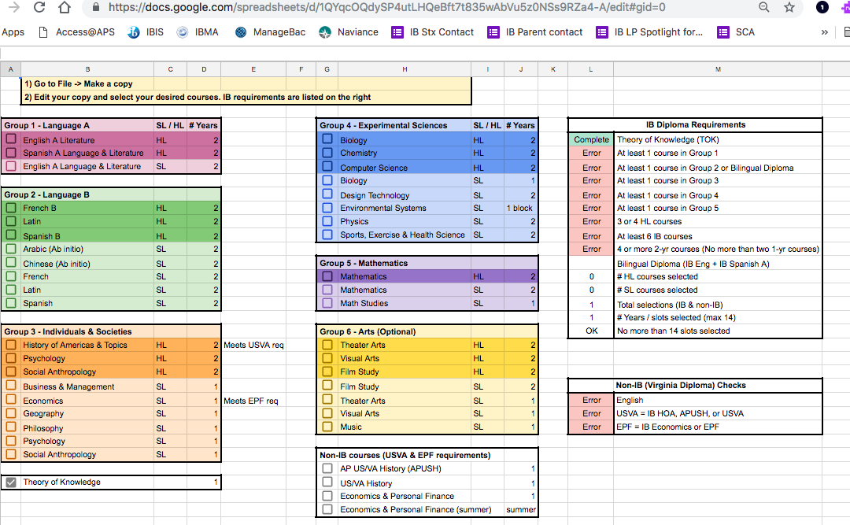
W-L IB Scheduling Tool
Will be updated and available on the Canvas course soon!
Notes:
In the next assignment you will be introduced to our schedule building tool that will allow you to try out different schedules.

Slide 27
Next Steps
Complete Canvas course (available by 1/16)
Required to pursue full IB
Enroll code
https://apsva.instructure.com/enroll/PFYX8F
Alternatively, https://apsva.instructure.com/register and use the following join code: PFYX8F
Complete by end of January

Slide 28
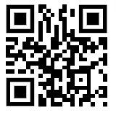
Please complete this quick feedback form to help us improve the program for future participants.
https://tinyurl.com/WLIBschedule
Thank you for participating this session!

