Slide 1
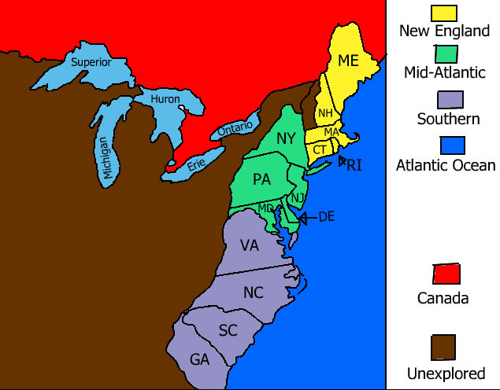
Development of the British Colonies

Slide 2
Economic Characteristics of the Colonial Period
The New England colonies developed an economy based on shipbuilding, fishing, lumbering, small- scale subsistence farming, and eventually, manufacturing. The colonies prospered, reflecting the Puritans’ strong belief in the values of hard work and thrift.
The Middle Colonies of New York, New Jersey, Pennsylvania, and Delaware developed economies based on shipbuilding, small-scale farming, and trading. Cities such as New York and Philadelphia began to grow as seaports and/or commercial centers.
Southern Colonies developed economies in the eastern coastal lowlands based on large plantations that grew cash crops such as tobacco, rice, and indigo for export to Europe. Farther inland, however, in the mountains and valleys of the Appalachian foothills, the economy was based on small-scale subsistence farming, hunting, and trading.
All had a strong belief in private ownership of property and free enterprise characterized colonial life everywhere.
The economic system of mercantilism used by imperial nations created a system of interdependence between the mother country and its colonies.

Slide 3
Social Characteristics of the Colonies
The middle colonies were home to multiple religious groups who generally believed in religious tolerance, including Quakers in Pennsylvania, Huguenots and Jews in New York, and Presbyterians in New Jersey. These colonies had more flexible social structures and began to develop a middle class of skilled artisans, entrepreneurs (business owners), and small farmers.
New England’s colonial society was based on religious standing. The Puritans grew increasingly intolerant of dissenters who challenged their belief in the connection between religion and government. Rhode Island was founded by dissenters fleeing persecution by Puritans in Massachusetts.
Virginia and the other Southern colonies had a social structure based on family status and the ownership of land. Large landowners in the eastern lowlands dominated colonial government and society and maintained an allegiance to the Church of England and closer social ties to Britain than did those in the other colonies. In the mountains and valleys further inland, however, society was characterized by small subsistence farmers, hunters, and traders of Scots-Irish, German, and English descent. Maryland was established with the intent of being a haven for Catholics.
While the cultural foundations in the North American colonies were British, American Indian and African cultures influenced every aspect of colonial society.
The Great Awakening was a religious movement that swept through Europe and the colonies during the mid-1700s. It led to the rapid growth of evangelical denominations, such as the Methodist and Baptist denominations, and challenged the established religious and governmental orders. It laid one of the social foundations for the American Revolution.

Slide 4
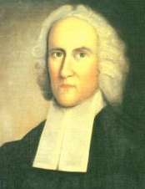
The First Great Awakening, 1730s and 40s
Began mostly in New England.
In the 16th and early 17th century, many people, because of the Scientific Revolution and the shift towards reasoning to figure things out, began moving away from religion.
However, in the late 17th and 18th Centuries, people began to find the need to return to religion.
One major figure of the Great Awakening was Jonathan Edwards, known mostly for his famous sermon "Sinners in the Hands of an Angry God." This fiery speech warned people against ignoring religion and its teachings and compared people's situation to a spider hanging by a thread over a hot fire.
“Unconverted men walk over the pit of hell on a rotten covering.”

Slide 5
Political Life in the Colonies
The first meeting of a representative government in Virginia occurred at Jamestown in 1619.
New England colonies used town meetings (an Athenian direct democracy model) in the operation of government.
Middle colonies incorporated a number of democratic principles that reflected the basic rights of
Englishmen. Southern colonies maintained stronger ties with Britain, with planters playing leading roles in
representative colonial legislatures.

Slide 6
The Development of Indentured Servitude and Slavery
Although all American colonies adopted African slavery as their primary non-free labor system, the growth of a plantation-based agricultural economy in the hot, humid coastal lowlands of the Middle and Southern colonies required a cheap labor source on a large scale.
Some of the labor needs, especially in Virginia, were met by indentured servants, who were often poor persons from England, Scotland, or Ireland who agreed to work on plantations for a period of time in return for their passage from Europe or relief from debts.
Most plantation labor needs eventually came to be satisfied by the forcible importation of Africans. Although some Africans worked as indentured servants, earned their freedom, and lived as free citizens during the colonial era, over time larger and larger numbers of enslaved Africans were forcibly brought to the American colonies via the Middle Passage.
The development of a slavery-based agricultural economy in the Southern colonies eventually led to conflict between the North and South in the American Civil War.

