Slide 1
Welcome to the NHS information meeting!
Please be sure to sign in at this link: http://bit.ly/NHSWLsignin- we must have record of your attendance to determine your eligibility to apply!
Notes:
Casey Dinan
Grace Franklin
Gideon Samson

Slide 2
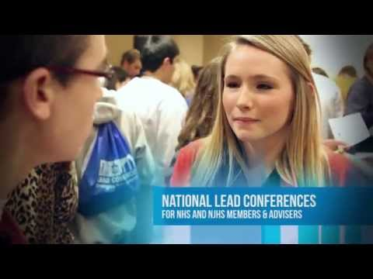
What is NHS?

Slide 3
National Honor Society Overview:
NHS is an organization founded to honor students who have excelled in areas of leadership, scholarship, service, and character
Students applying for membership in NHS cannot be discriminated against because of race, gender, ethnicity, political persuasion, socioeconomic background, disability, rumor or any other characteristic unrelated to the criteria for selection of NHS.

Slide 4
NHS Commitments at WL:
$15 annual dues ($30 total between your junior and senior year)
10 community service hours your first year, 20 your second
Mandatory school sponsored NHS events such as Green the Grounds, Holiday Bazaar, etc.,
3 NHS meetings a semester

Slide 5
Benefits of joining NHS
Excellent on college applications
Opportunities to serve the community with your peers
Social activities with other students in NHS
NHS exclusive volunteer opportunities, college workshops, and social activities
Special cord and tassel at graduation

Slide 6
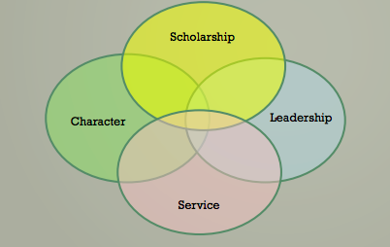
Evaluation Criteria

Slide 7
Scholarship
By being present at this meeting you have already met the criteria for scholarship. Scholarship criteria indicates that you have a cumulative GPA of 3.5 or higher

Slide 8
Character Guidelines
Takes criticism willingly and accepts recommendations graciously
Constantly exemplifies desirable qualities of personality (cheerfulness, friendliness, poise, stability)
Cooperates by complying with school regulations concerning property, programs, office, halls etc.,
Demonstrates highest standards of honesty and reliability, shows courtesy, concern and respect for others
Observes instructions and rules, punctuality, and faithfulness in obligation both inside and outside the classroom
We anticipate as WL Generals all students will meet the character guidelines outlined here, barring any significant disciplinary history.

Slide 9
Leadership Guidelines
Resourceful in proposing new problems, applying principles and making suggestions
Demonstrates leadership both inside and outside of school
Contributes ideas and actions that improve the civic life of the school
Is able to delegate responsibilities
Exemplifies positive qualities and inspires positive behavior in others
Demonstrates academic initiative and displays leadership in classroom, at work, and in school activities
Holds school offices/ positions of responsibility, conducts business efficiently, and is reliable and dependable

Slide 10
Service Guidelines
Participates in some out of school service activities
Dependable volunteer that provides well-organized assistance and is available to sacrifice their own time to help others without compensation
Works well with others and is willing to take on difficult responsibilities
Is willing to render cheerful and enthusiastic to others both in and outside school
Willing to respect others
Readiness to show courtesy by assisting visitors, teachers, or students

Slide 11
Application Guidelines
There are a few copies of the application available today- please see the WL NHS website to download a copy
Prior to completing the application please review NHS selection guidelines and membership responsibilities
Complete all aspects of the application and submit to Ms. Bennett no later than December 10th.

Slide 12
Acceptance Process
Following receipt of applications, the NHS Faculty Council will review applications (likely the second week of December)
Those accepted and those denied will receive confirmation the Friday before Winter Break

