Slide 1
IB - The Diploma Program - Year 2
Julie Cantor, IB DP Coordinator
@WLHSIBProgram

Slide 2
IB Mission

Slide 3
IB MISSION STATEMENT
The International Baccalaureate aims to develop inquiring, knowledgeable and caring young people who help to create a better and more peaceful world through intercultural understanding and respect.
To this end the organization works with schools, governments and international organizations to develop challenging programmes of international education and rigorous assessment.
These programmes encourage students across the world to become active, compassionate and lifelong learners who understand that other people, with their differences, can also be right.

Slide 4
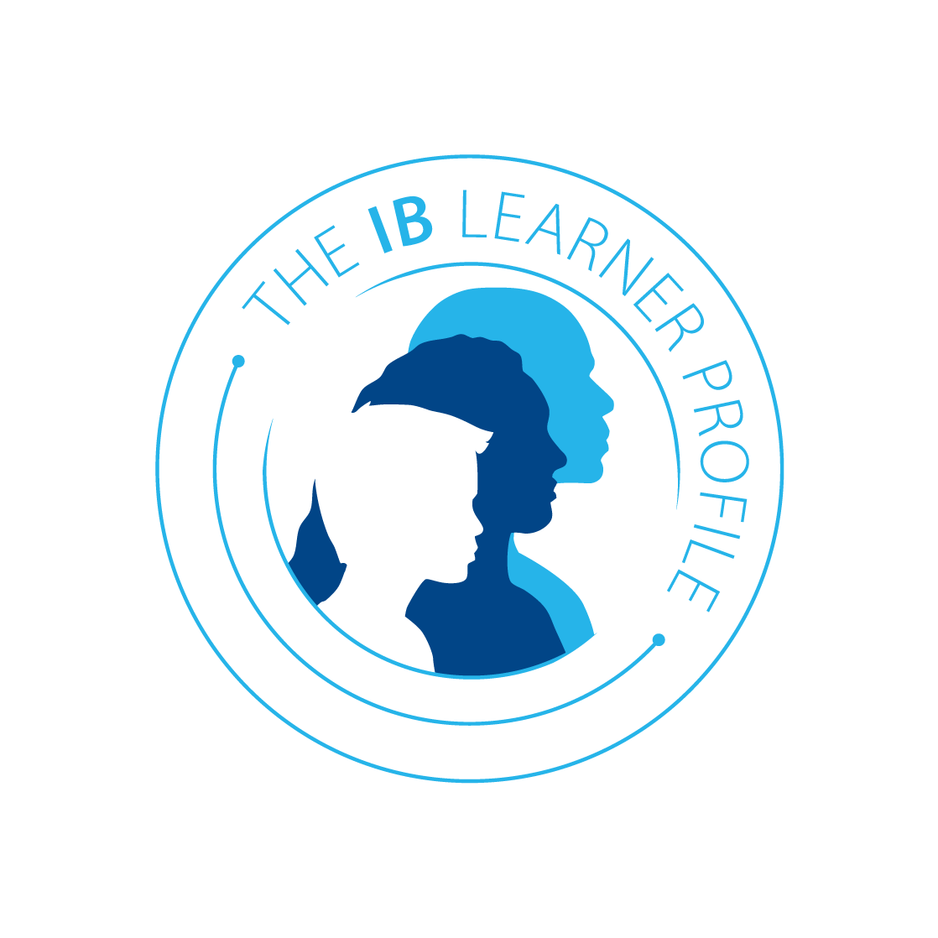
International Baccalaureate | Washington-Lee High School
The International Baccalaureate aims to develop inquiring, knowledgeable and caring young people who help to create a better and more peaceful world through intercultural understanding and respect. To this end the organization works with schools, governments and international organizations to develop challenging programmes of international education and rigorous assessment. These programmes encourage students across the world to become active, compassionate and lifelong learners who understand that other people, with their differences, can also be right. | MISSION STATEMENT Washington-Lee High School challenges all students to strive for the best, to become lifelong learners, and to become successful, active members of the global community. VISION At Washington-Lee we believe we can achieve our best when working together in a caring, stimulating, and safe environment. We value the development of the whole child as well as the development of our educators. We strive to provide learners and teachers opportunities to explore their interests, broaden their horizons, and develop their talents and creativity. We take pride in our work and celebrate our accomplishments. We encourage the involvement of families and the community and actively work to maintain these connections. We respect, value, and celebrate diverse traditions, beliefs, languages and cultures of our students, teachers, and staff. Washington-Lee will always pioneer excellence and equity in all of us and for all of us.
LEARNER PROFILE TRAITS
INQUIRERS
KNOWLEDGEABLE
THINKERS
COMMUNICATORS
PRINCIPLED
OPEN-MINDED
CARING
BALANCED
RISK-TAKERS
REFLECTIVE
Mission statement in action

Slide 5
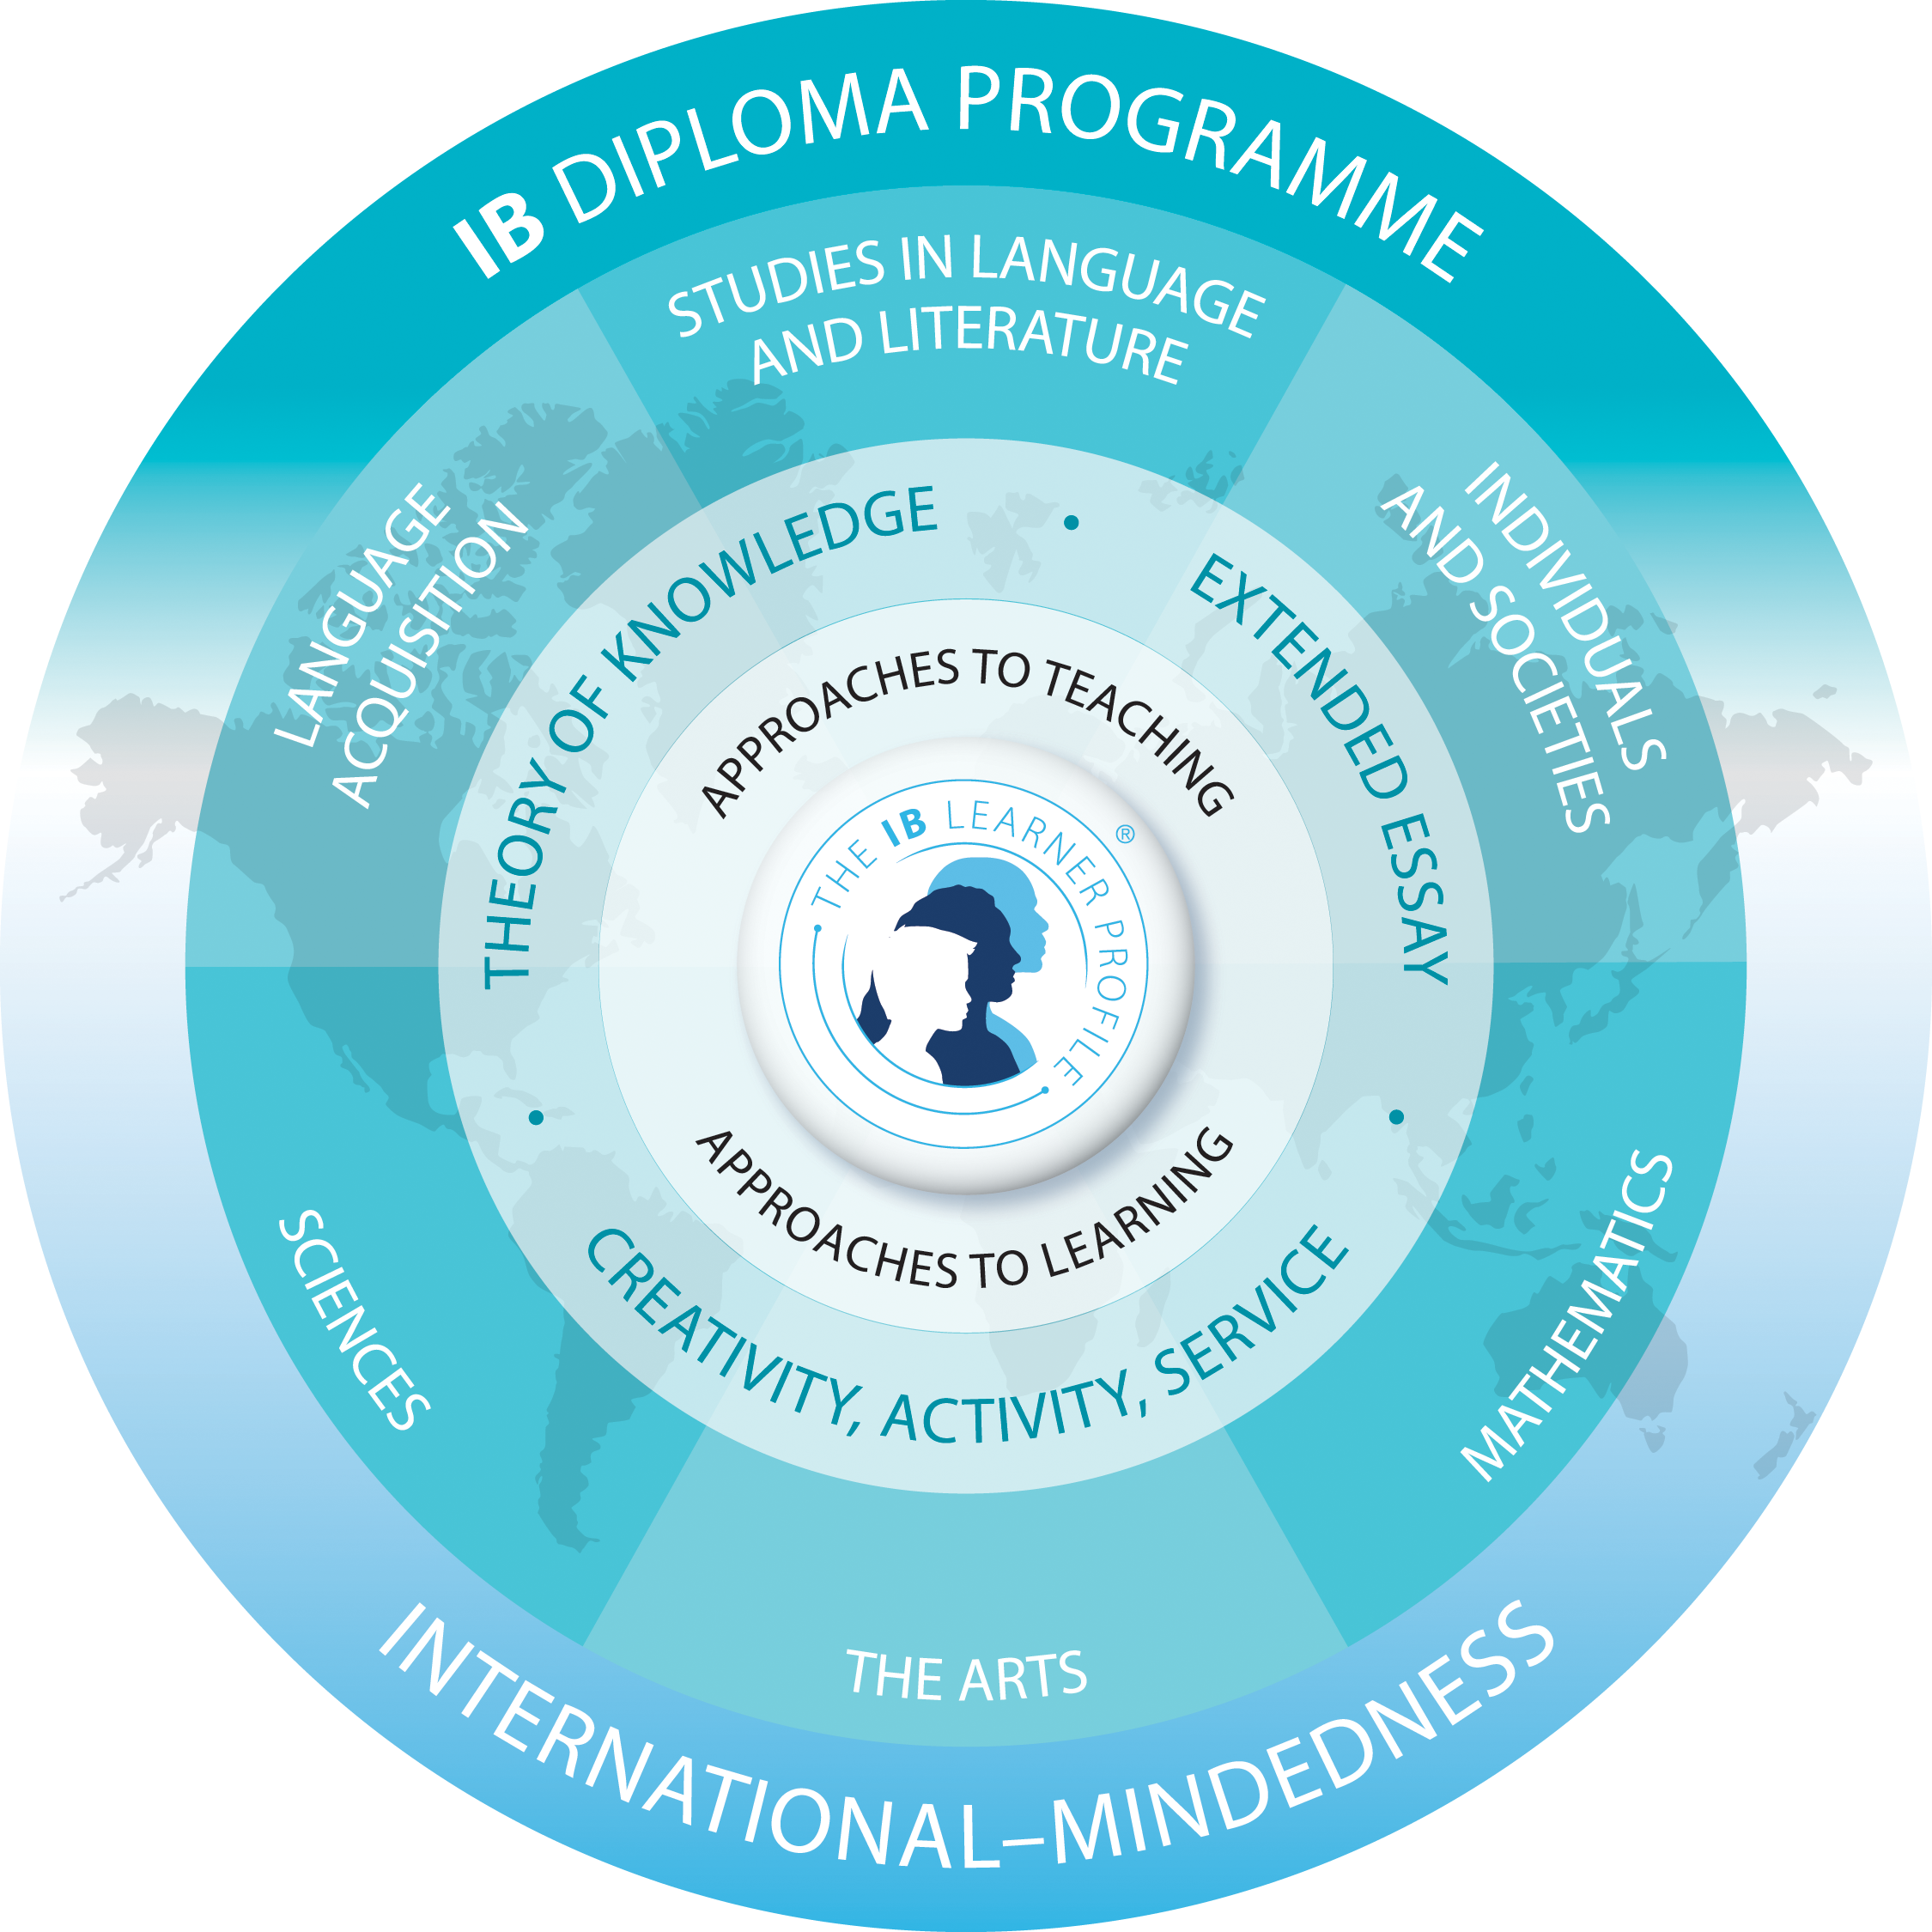
International-Mindedness
From “What is an IB Education?” May 2017
To be open to the world, we need to understand it. IB programmes therefore provide students with opportunities for sustained inquiry into a range of local and global issues and ideas. This willingness to see beyond immediate situations and boundaries is essential as globalization and emerging technologies continue to blur traditional distinctions between the local, national and international.
An IB education fosters international-mindedness by helping students reflect on their own perspective, culture and identities, and then on those of others. By learning to appreciate different beliefs, values and experiences, and to think and collaborate across cultures and disciplines, IB learners gain the understanding necessary to make progress toward a more peaceful and sustainable world.

Slide 6
What does the IB Diploma Program curriculum contain?
Junior and senior years
Six IB courses from 5-6 subjects
Core components
Concurrent study
Three subjects - higher level (HL) - 240 hours of instruction
Three subjects - standard level (SL) - 150 hours of instruction
Focus on whole student, providing students with a broad international view of world and student’s context within it.

Slide 7
The Core
Creativity-Activity-Service (CAS)
Pass/fail
Requirements either met or not met
Extended Essay (EE)
Grade: A-E
Combines with TOK to contribute up to 3 points toward IB Diploma score
Theory of Knowledge (TOK)
Combines with EE to contribute up to 3 points toward IB Diploma score
Grade: A-E

Slide 8
What is Special About IB Assessment?
IB assessment is rigorous, criterion-related, consistent and differentiating of student ability.
•Student work is assessed using worldwide standards-based rubrics by external and internal examiners
•Externally there are 4,000+ examiners worldwide
•Multiple methods of assessment for each course
•Balance between independent and teacher supervised work
•Transparency – Ongoing evaluation
•Curriculum – 5 year review cycle

Slide 9
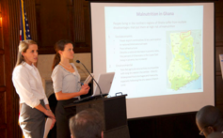
Internal Assessment - The IA
Expamples include:
•oral work in languages
•fieldwork in geography
•laboratory work in the sciences
•investigations in mathematics
•artistic performances
Assessments are checked by external examiners and normally contribute between 20% and 30% of the total mark.

Slide 10
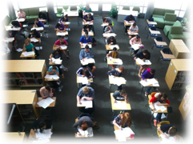
External Assessment
Examinations form the basis of the assessment for most courses because of their high levels of objectivity and reliability. They include:
•essays
•structured problems
•short-response questions
•data-response questions
•text-response questions
•case-study questions
•multiple-choice questions (limited use of these)

Slide 11
Important Dates for IB Diploma candidate seniors
Monday, September 23 | IB DP20 - CAS Verification Summer Supervisor Review forms
Monday, September 23 | REVISED: EE full draft DP20
In GP | IB Exam Registration
Wednesday, October 2 | IB DP20 EE Seminar - Formatting the EE
Friday, November 8 | DP20 Final EE paper
Wednesday, December 11 | IB EE Viva Voce - DP20
November 18-December 13 | IB DP20 CAS 3rd Advisement meeting (Seniors make 20 minute CAS advisement appointments)
Monday, February 24 | IB DP20 - Final CAS Verification- Supervisor Review forms
Monday, March 23 | IB Visual Arts Exhibition: open to public 3-8pm
Monday, March 23 | IB CAS Orientation DP22 & Demonstration DP20
Friday, May 1 - 22 | IB Exams
Tuesday, May 26 | Senior Experience begins

Slide 13
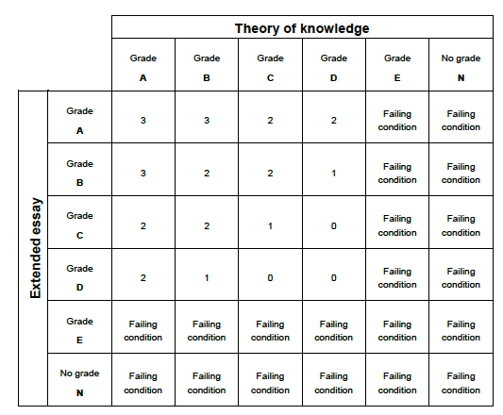
Diploma points matrix

Slide 14
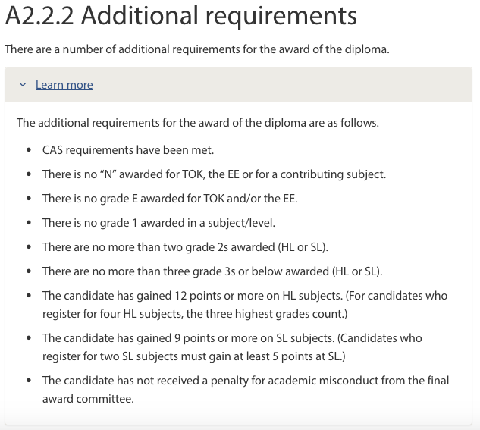
Awarding the diploma
24 points!

Slide 15
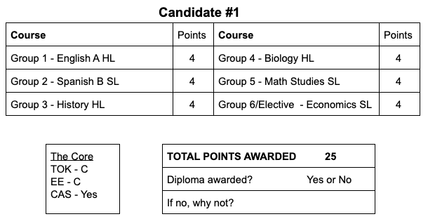
Awarding the diploma

Slide 16
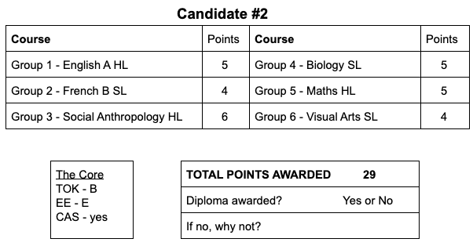
Awarding the diploma

Slide 17
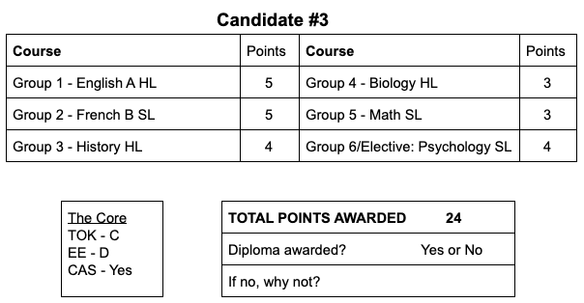
Awarding the diploma

Slide 18
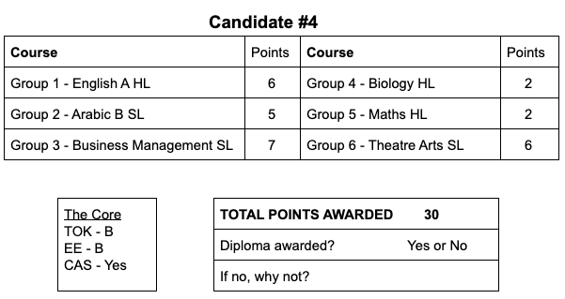
Awarding the diploma

Slide 19
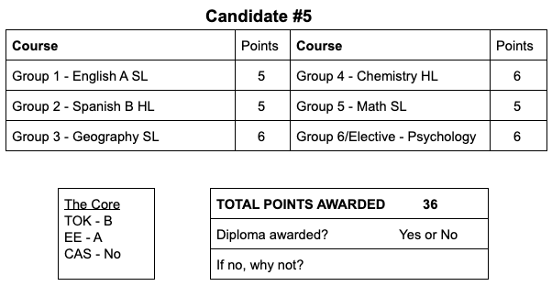
Awarding the diploma

Slide 20
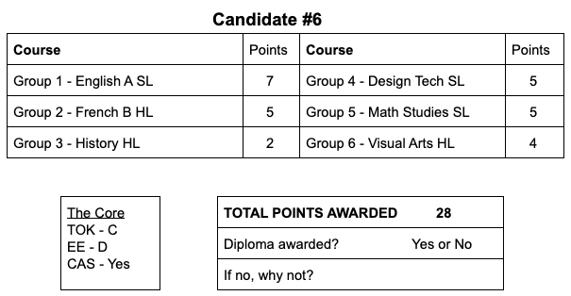
Awarding the diploma

Slide 21
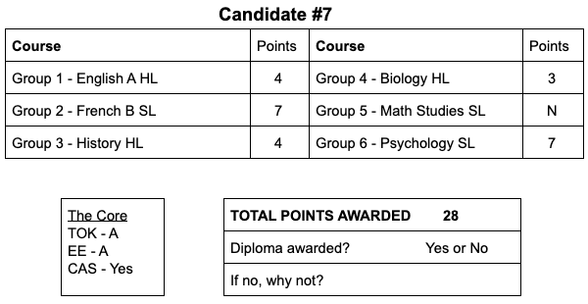
Awarding the diploma

Slide 22
Awarding the diploma

Slide 23
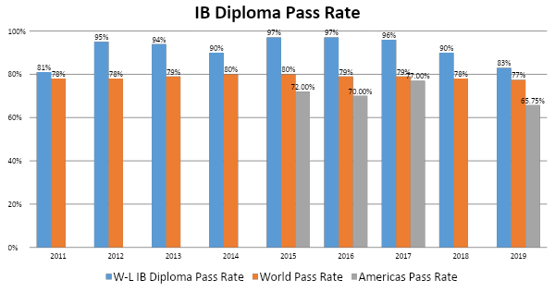
Notes:
JULIE

Slide 24
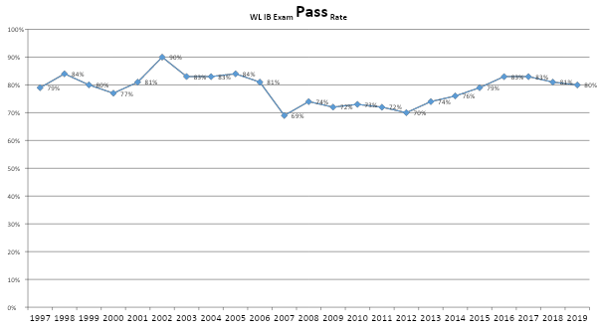
To pass a student must score a 4 or better (out of 7)

Slide 25
College and University Destinations Class of 2019
Arizona State University, Barnard College, Bishop’s University, Brandeis University, Brown University, Bryn Mawr College, Catholic University of America, Clark University, College for Creative Studies, College of William & Mary, College of Wooster, Connecticut College, Cornell University, Denison College, Duke University, George Mason University, Georgetown University, Hampton-Sydney College, Indiana University, James Madison University, King's College London, Loyola Marymount University - LA, McGill University, New York University - Abu Dhabi, Northeastern University, Northwestern University, Pennsylvania State University, Princeton University, University of California - San Diego, University of Colorado, University of Florida, University of Mary Washington, University of Michigan, University of Pennsylvania, University of St. Andrews, University of Texas - Austin, University of Toronto, University of Vermont, University of Virginia, University of Wisconsin, Villanova University, Virginia Commonwealth University, Virginia Tech, Washington and Lee University, Wesleyan University

Slide 26
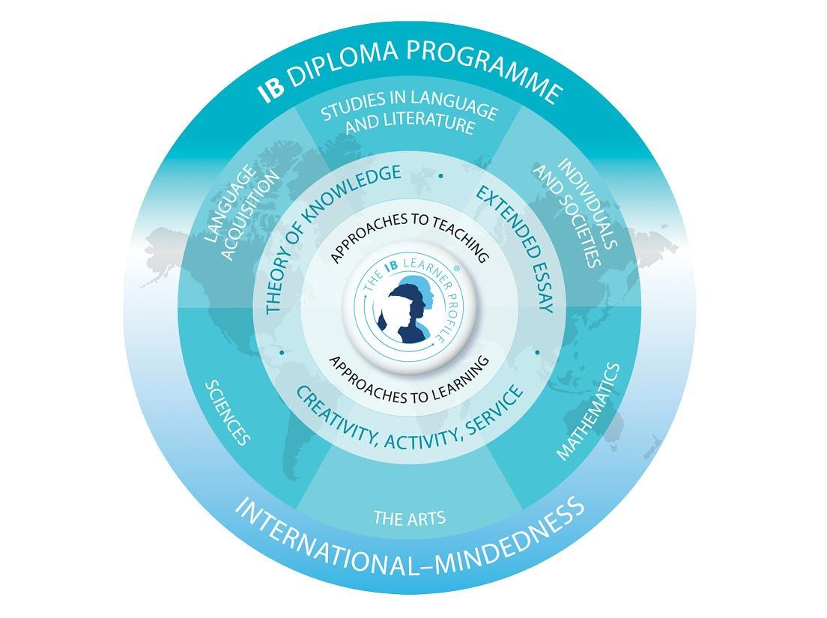
University acceptance rate

Slide 27
What can you do?
Be aware of the assessment cycle: most IA’s due December - April; exams in May senior year.
Talk to your child about when her/his IA’s are due.
Suggest your child develop a plan to be organized for the busy months of Dec-May
Check in periodically to see they are sticking to their plan
Be supportive and encouraging, but….
Know that your child needs to do this
Communicate with IB Coordinator

Slide 28
Resources
Washington-Liberty High School IB site
May Exam schedule and information
What is an IB Education?
50 Years of IB
IB: College acceptance rate

Slide 29
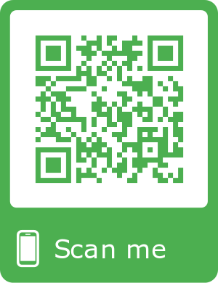
Feedback:
?
https://tinyurl.com/WLIBSeniorParent

